Slide 1

Predicting Parkinson’s Progression with Voice Telemonitoring & ML
Predicts UPDRS scores using voice signals and demographic data
Name: [Student Name]
Supervisor: [Supervisor Name]
University: [University Name]
Date: [Date]

Slide 2

INTRODUCTION
The Challenge of Parkinson's Disease Assessment
The Problem
Our Solution
PD affects millions, causing progressive motor and non-motor symptoms.
ML models predict UPDRS scores using voice and demographic data for objective assessment.
Current UPDRS assessments are subjective, time-consuming, and require clinical visits.
Voice analysis identifies early speech impairments linked to disease severity.

Slide 3
RESEARCH FOCUS
Problem Statement & Research Questions
1
2
3
Problem Statement
Research Question 1
Research Question 2
UPDRS assessments are subjective.
What are the most significant acoustic features that correlate with motor and total UPDRS scores in Parkinson’s patients ?
Which regression model Voting Regressor, Long Short Term Memory(LSTM), and Gated Recurrent Unit(GRU) provides the most accurate and interpretable prediction of UPDRS scores, and what are the features that contribute to the prediction of score for Motor Examination and the sum of the scores of the 4 parts of UPDRS?
Require experienced clinicians.
Logistical challenges for patients.

Slide 4
OBJECTIVES
Study Objectives
01
02
Data Visualization
Model Training
Generate plots from voice data
Train ML models
Analyze patterns
Predict Motor and total UPDRS scores
03
04
Feature Analysis
Performance Assessment
Use Explainable AI (XAI)
Evaluate models
Identify key predictive factors
Use performance metrics

Slide 5

LITERATURE REVIEW
Related Work
Study
Data Type
Target
Metric
Key Findings
Hamzehei et al. (2023)
Voice
Total
R² = 0.904
Adam optimization best
Guo et al. (2025)
Wearables
Part III
Acc = 87-93%
Smartphone motor task assessment
Rehman et al. (2021)
Wearables
Part III
MAE = 6.29
CNN with gait data
Nilashi et al. (2022)
Voice
Both
MAE = 0.721
SVR with clustering
Shahid & Singh (2020)
Voice
Both
R² = 0.970
DNN + PCA feature reduction
Research Gap: Limited studies using ensemble methods like Voting Regressor for UPDRS prediction with interpretable results

Slide 6
DATASET
Parkinson's Tele-monitoring Dataset
5875
8
2
Voice Samples
Features
Target Scores
From 42 Parkinson's patients
Age, Jitter, Shimmer, NHR, HNR, RPDE, DFA, PPE
Total UPDRS
Motor Exam (Part III)
Voice Features Defined
Jitter: Frequency variation
Shimmer: Amplitude variation
HNR: Harmonic-to-Noise Ratio
RPDE: Recurrence Period Density Entropy

Slide 7
DATA ANALYSIS
Exploratory Data Analysis: Key Patterns
Age Distribution
Voice Features
UPDRS Correlation
Right-skewed
Jitter & Shimmer: right-skewed
Motor & Total UPDRS: strong positive correlation
More younger patients
Lower values prevalent

Slide 8





METHODOLOGY
Research Methodology: CRISP-DM Framework
Data Understanding
Business Understanding
Analyze voice data patterns
Define UPDRS objectives
Data Preparation
Clean & standardize features
Evaluation
Evaluate R², RMSE, MAE
Modeling
Train Regressor, LSTM, GRU

Slide 9



IMPLEMENTATION
Data Preprocessing & Feature Engineering
Feature Selection
Standardization
Train-Test Split
Removed irrelevant features.
Normalized features (StandardScaler).
80/20 data split.
Machine Learning Models Implemented
Voting Regressor
LSTM Network
GRU Network
Base Models: RF, DT, SVR.
Architecture: LSTM (64), Dense (32, 8), Output (1).
Architecture: GRU (64), Dense (32, 8), Output (1).

Slide 10
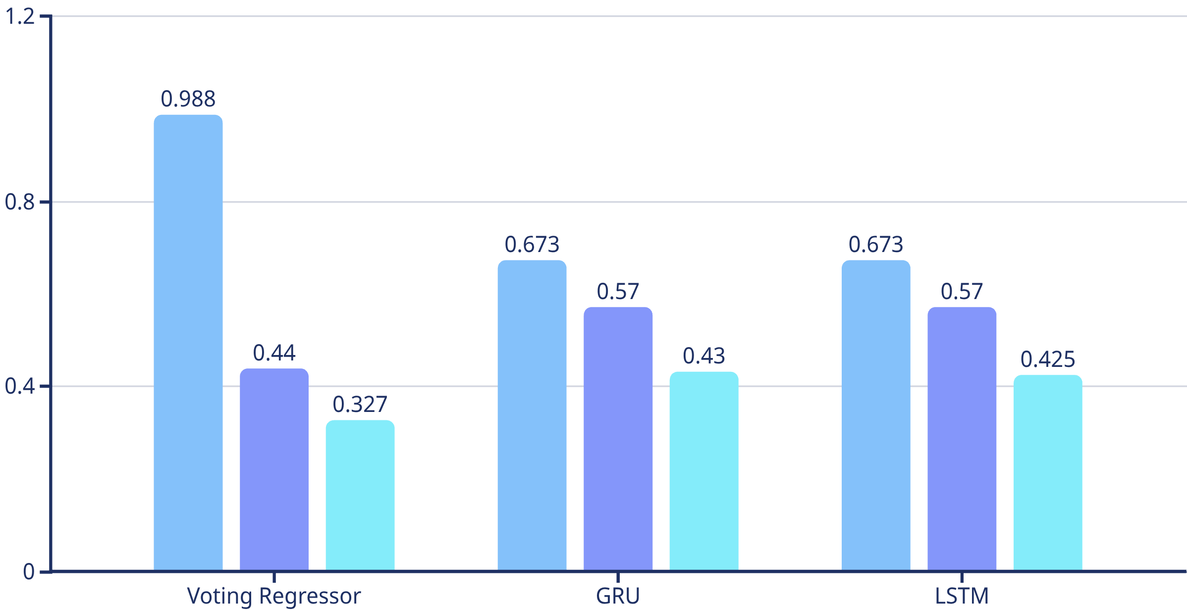

RESULTS
Model Performance: Total UPDRS Score Prediction
R² Score
RMSE
MAE
Winner: Voting Regressor (R²: 0.9883) outperformed other models with lowest error metrics.

Slide 11
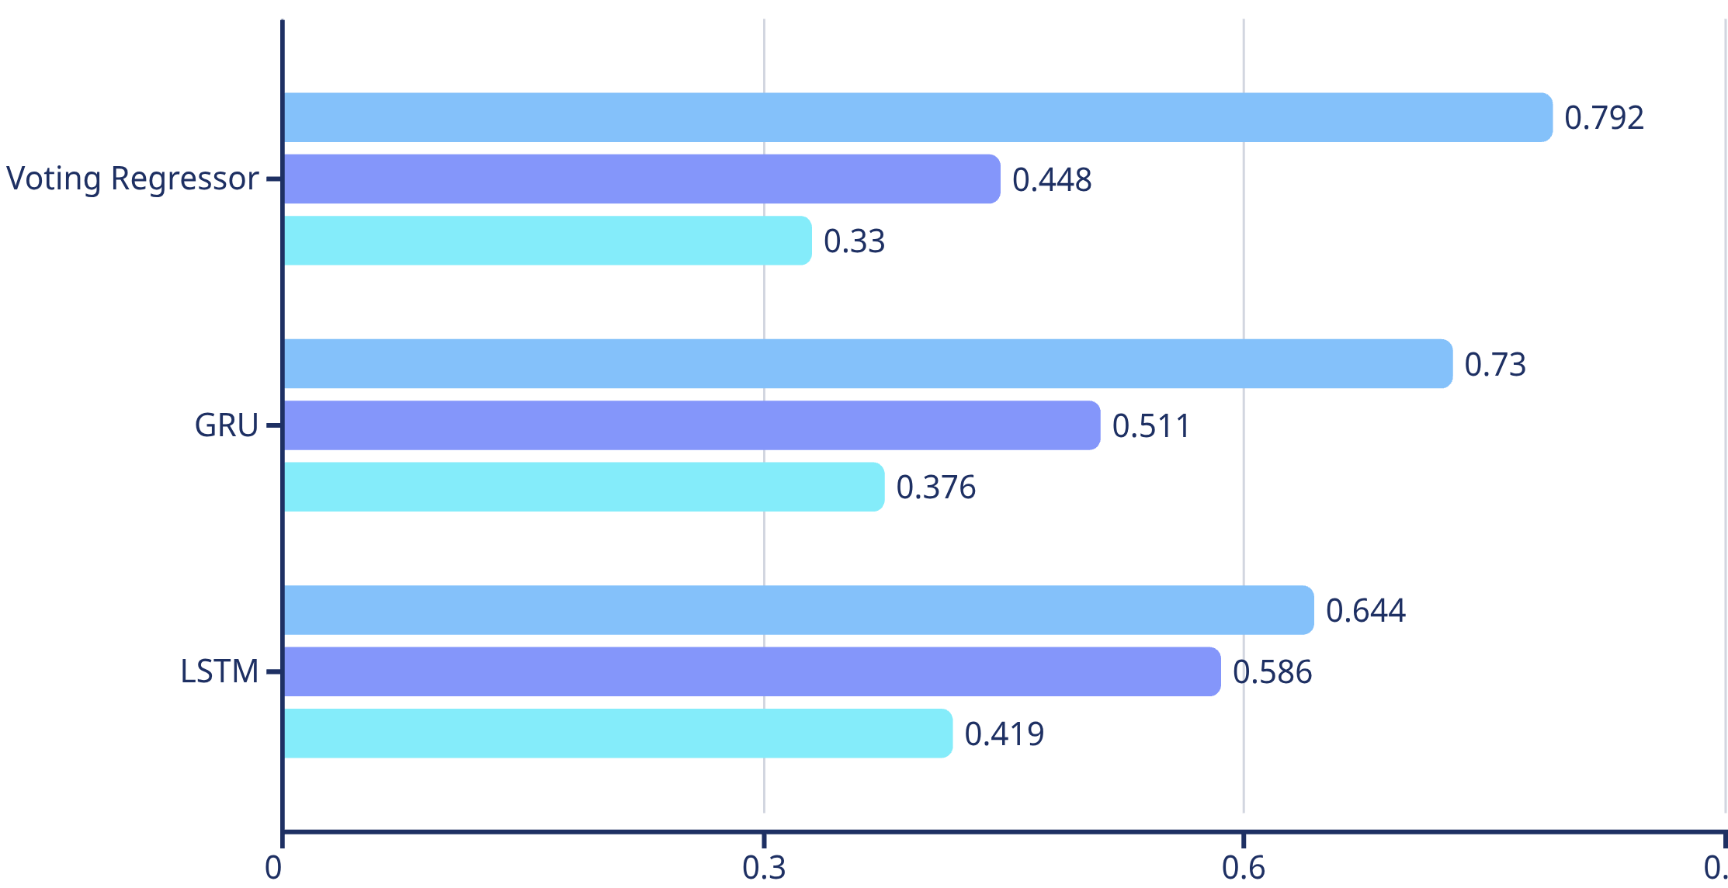
RESULTS
Model Performance: Motor Examination Score Prediction
R² Score
RMSE
MAE
Performance
Error Metrics
Voting Regressor: Superior R² (0.792)
Lowest MAE (0.33): minimal error
Outperformed deep learning models
Crucial for clinical use

Slide 12
INTERPRETATION
SHAP Analysis: Feature Importance for Total UPDRS
Age
Shimmer:APQ11
Strong positive impact.
Positive SHAP values; higher shimmer correlates with better prediction.
DFA
Other Features
Mixed distribution, complex relationship.
Varying influences from HNR, RPDE, PPE, NHR, Jitter(%).

Slide 13
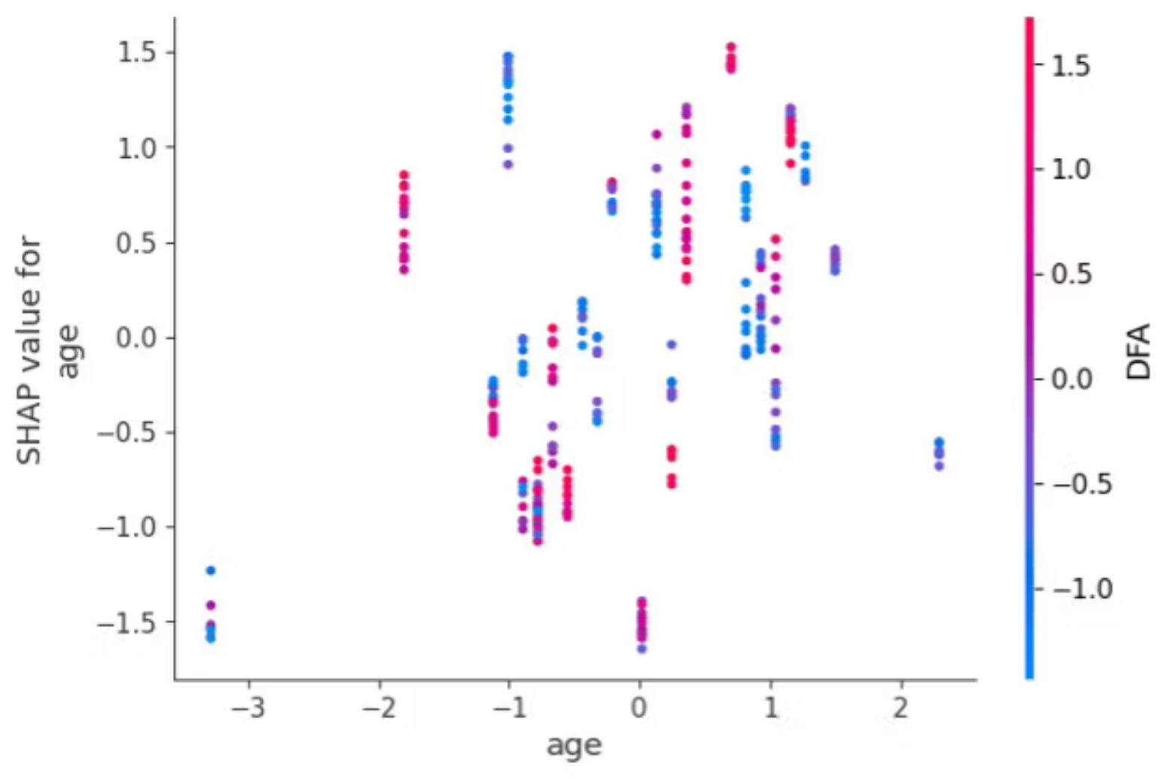
INTERPRETATION
SHAP Analysis: Feature Importance for Motor Score
Age Feature
Findings
SHAP values range from -1.5 to 1.5.
DFA: Higher scores link to better motor prediction.
Diverse impact on motor scores.
Age: Complex relationship, moderated by voice features.
Shimmer:APQ11: Complex relationship with motor symptoms.
Voice characteristics interact with demographics.

Slide 14
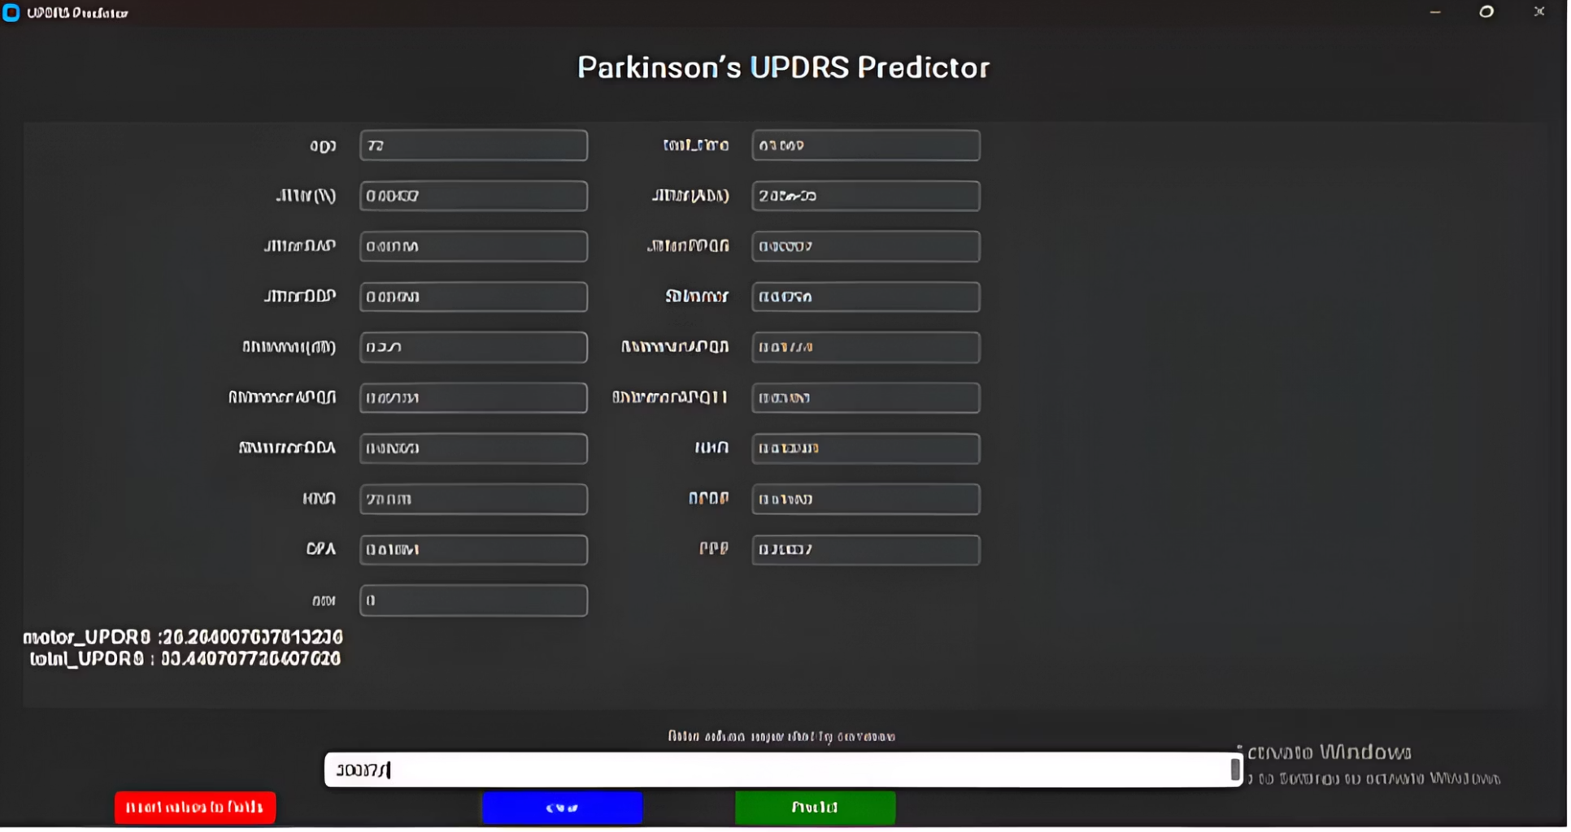
Prototype Desktop Application
Predicts UPDRS and UPDRS-III motor scores.
Built using Python's Tkinter library.
Integrates a trained Voting Regressor.
Input fields for all relevant dataset features.
'Predict' button processes inputs through the model.
Displays predicted total UPDRS and motor scores.
Supports batch predictions via CSV input.

Slide 15
NOVELTY
Novelty & Benefits of This Research
Ensemble Approach
Interpretable Predictions
Non-Invasive Assessment
First to use Voting Regressor (RF, DT, SVR) for UPDRS prediction, achieving R² = 0.9883.
SHAP analysis clarifies feature importance; age and shimmer are key predictors.
Voice-based prediction enables remote monitoring, reducing need for in-person visits.
Clinical Impact
Addresses subjectivity and accessibility in traditional UPDRS assessment.
Offers objective, scalable evaluation for patients, especially in remote areas, with high accuracy (R² = 0.9883).

Slide 16
FUTURE WORK
Limitations & Future Enhancements
Current Limitations
Future Enhancements
Dataset Size
Deep Learning
Small dataset
Deep learning integration
Base Models
Advanced Ensembles
Conventional models
Advanced ensembles
Sequence Modeling
Sequence Modeling
Non-sequential data
Sequential data processing
Larger Datasets
Larger, diverse datasets

